Slide 1
Game Concept
2D Co-op Cooking Game
Turn-based Multiplayer
Tap to pick ingredient
Select ingredients and follow the recipe
Time-based Progression
Players to will scored on completion time and difficulty of recipe
Symmetric Gameplay

Slide 2
The ingredients are on a moving conveyer belt, constantly rotating.
Players must select their required ingredient while the conveyer belt is moving.
One player gets one ingredient then the other player the next ingredient, this process goes on until they complete the recipe
Players must complete the recipe, the quicker the completion of the recipe, the better the score.
Each recipe will have different ingredients and different completion times.
Game will end if the players cannot complete the recipe in the required time.

Slide 3
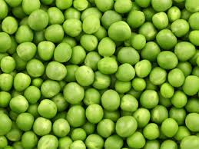
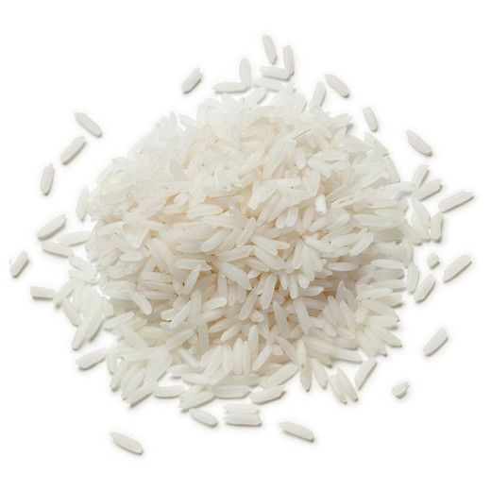

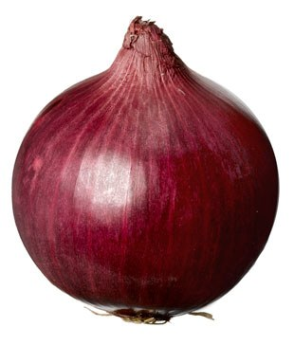
Time: 0:00
Recipe:
Recipe:
YOUR TURN!
Time: 0:00

